Slide 1
Predator-Prey Swarming Model
Luca Tondelli, Jonas Purtschert

Slide 2
Overview
Model presentation
Interpreting the parameters
Simulation results & Discussion
Summary & Outlook

Slide 3
The Base Model (BM)
Vladimir Zhdakin, J. C. Sprott
2 agents: predator, prey
2 dimensional
No environment interaction except friction
#preys > #predators

Slide 4
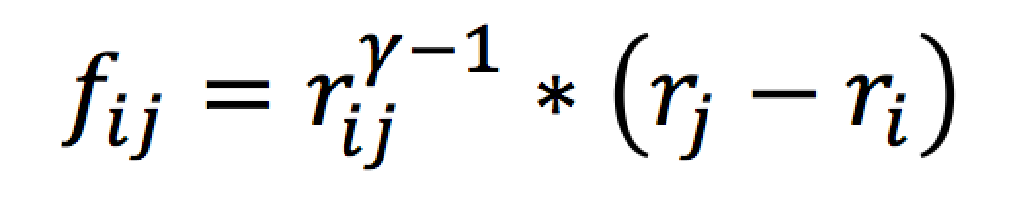
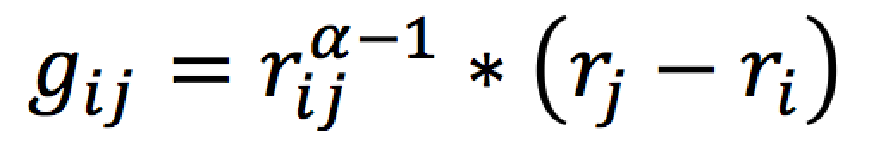
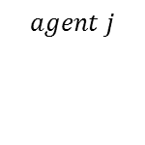

BM: Prey to Prey Forces
Radial
Power laws
Long-range (attractive)
Short-range (repulsive)

Slide 5
BM: Predator to Predator Forces
Same as preys (swarming)
Long-range attractive
Short-range repulsive
Only repulsive (spreading)
Long-range repulsive
Short-range repulsive
No force

Slide 6
BM: Prey to Predator Forces
Only long-range repulsive / attractive

Slide 7
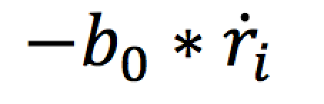
BM: Friction
On prey and predator
The only environment force

Slide 8
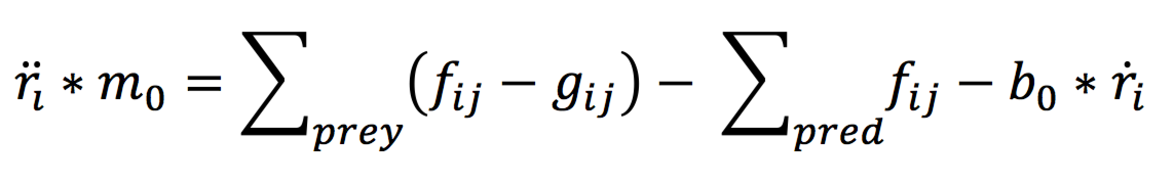
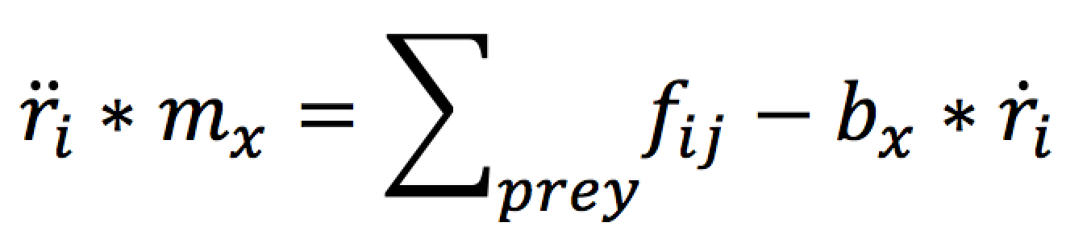
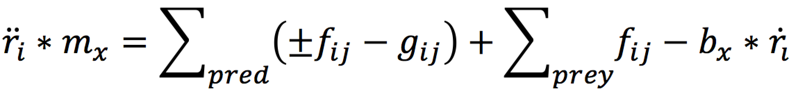
BM: Resulting Forces
Prey:
Predator:

Slide 9
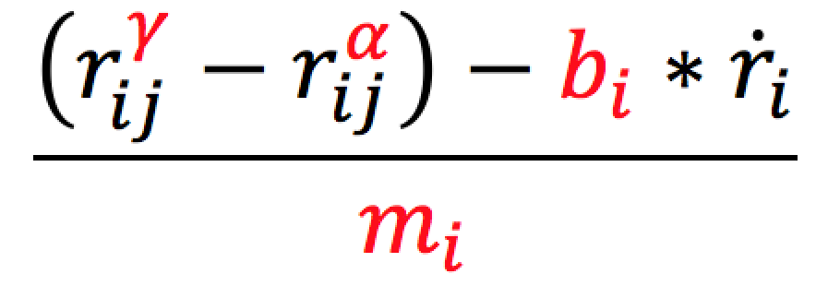
Interpretation of the Parameters (IP)
Motion parameters γ and α
The mass m
The friction b

Slide 10
IP: Motion Parameters
γ and α have to be negative
γ > α

Slide 11
IP: Motion Parameters
Difference between γ and α? -> 1

Slide 12
IP: Motion Parameters
Value of α? -> -1

Slide 13
IP: The Mass
Defines acceleration
Too big:
Slow acceleration
Fast stabilization
Too small:
Fast acceleration (jumping)
No stabilization
0.1 ≤ m ≥ 1

Slide 14
IP: Friction
Avoid outbreaks / hold swarm together
Too big:
Slow movement
Swarm always together
Too small:
Outbreaks
0.1 ≤ m ≥ 1

Slide 15
Simulation Results & Discussion (SD)
Trivial case
Multiple Predator
Hunting Methods

Slide 16
SD: Trivial Case
Equation simplifies to:
Always equilibrium except friction removed

Slide 17
SD: Trivial case equilibrium
$$m0=0.1, b0=0.1, 8 preys$$

Slide 18
SD: Multiple Predator
Three subcases to consider
No interaction
Attractive force
Repulsive force

Slide 19
SD: No interaction
Used formula for preys:
For predators

Slide 20
SD: Results (no interaction)
In general the results are
Chaotic
Sometimes move along same trajectory but split normally after a while
Approx. same behaviour as attractive case (next)
Remarkable results (which specific parameters)
First looks chaotic, but after a while predators circle in periodic way around swarm
Hunting technic?

Slide 21
SD: No interaction example video
//video with which parameters?

Slide 22
SD: Pred. with attractive force
Formula for preys:
Formula for predators:

Slide 23
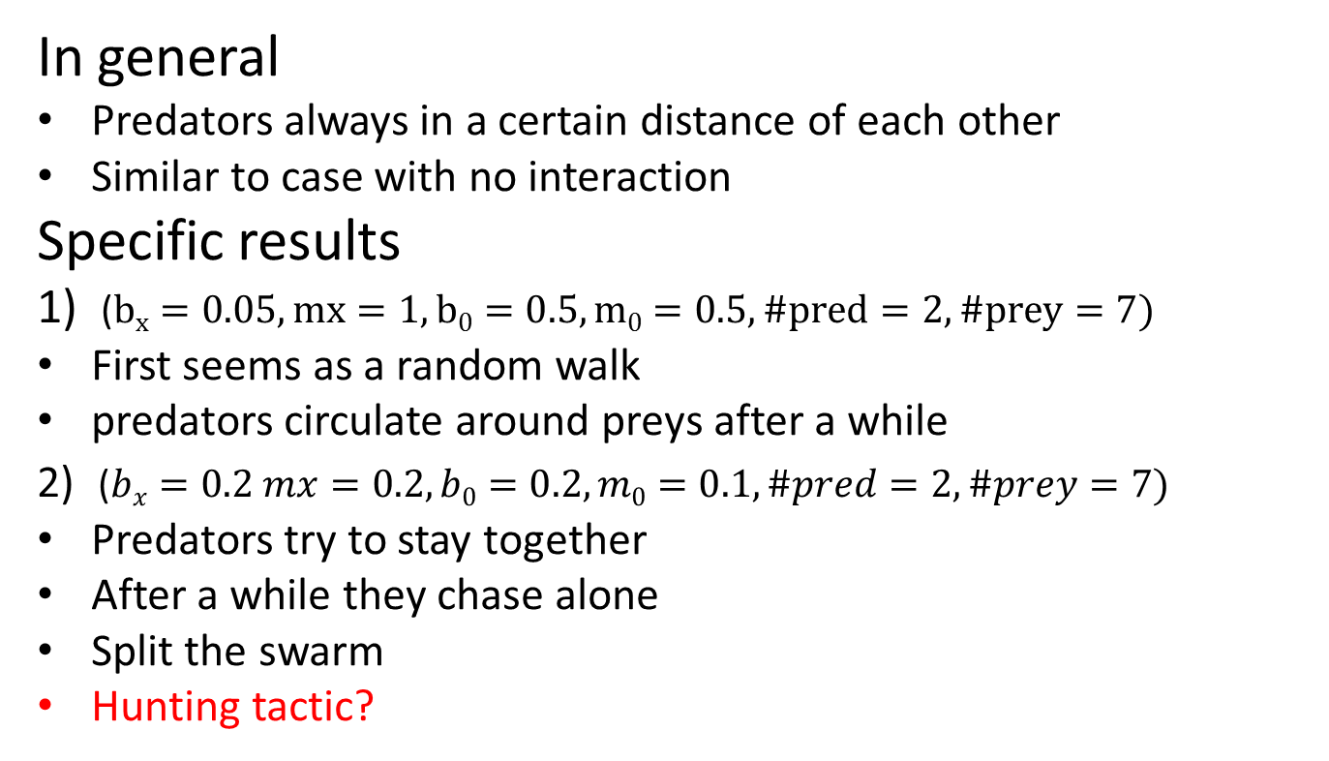
SD: Results (attractive force)
In general
Predators always in a certain distance of each other
Similar to case with no interaction
Specific results
1) ($bx=0.05, mx=1, b0=0.5, m0=0.5, \#pred=2, \#prey=7)$
First seems as a random walk
predators circulate around preys after a while
2) ($bx=0.2 mx=0.2, b0=0.2, m0=0.1, \#pred=2, \#prey=7)$
Predators try to stay together
After a while they chase alone
Split the swarm
Hunting tactic?

Slide 24
SD: Attractive force example video
//video with which parameters?

Slide 25
SD: Pred. with repulsive force
Formula for preys
Formula for predators

Slide 26
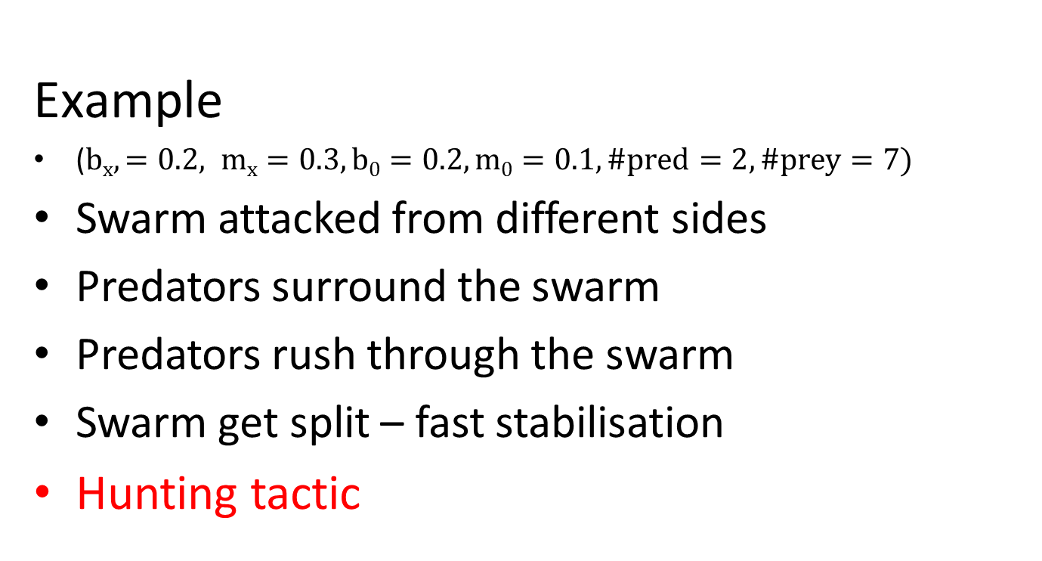
SD: Results (repulsive force)
Example
($bx,=0.2, mx=0.3, b0=0.2, m0=0.1, \#pred=2, \#prey=7)$
Swarm attacked from different sides
Predators surround the swarm
Predators rush through the swarm
Swarm get split – fast stabilisation
Hunting tactic

Slide 27
SD: Attractive force example video
//video with which parameters?

Slide 28
SD: Videos
Chaotic Video
Circling Video
Separation Video

Slide 29
Discussion of the results
Realistic / unrealistic results

Slide 30
Summary & Outlook (SO)
Advantages of the model
Simplicity
Reproduce basic behavior of swarming
Group / autonomous behavior
Disadvantages of the model
Too simple for a accurate / specific swarming behavior
Ignore important parameters / constraints

Slide 31
What could be improved?
Add more parameters (e.g. randomness)
Add food for preys
Angle of vision
Current / wind
Specific hunt tactic
Penis schrieb no eine do ahne!

Slide 32
Practical use and last words
Described model good approximation for its simplicity
Optimality of the swarm behavior?
Such models can be used in technical applications (e.g. unmanned vehicles, robots etc.)
Model of this paper clearly to simple – but gives a good flavour how this can be achieved

Slide 33
Thanks for your attention!

